Slide 1
Chapter 2
Building C# Applications

Slide 2
Objectives
Introduction to .NET development tools
Visual Studio 2008

Slide 3
Content
The C# Command-Line Compiler
The Command-Line Debugger
Building .NET Applications Using Visual C# 2008
Home reading

Slide 4
The C# Command-Line Compiler
Able to create .NET assemblies using the C# command-line compiler, csc.exe
Reasons for using C# command line Compiler
Configuring the C# Command-Line Compiler
  Use either a – or / (e.g., csc -? or csc /?) to specify command-line arguments for a given .NET development tool.
Configuring Additional .NET Command-Line Tools

Slide 5
Building C# Applications using csc.exe
// A simple C# application.
using System;
class TestApp
{
  public static void Main()
{ Console.WriteLine("Testing! 1, 2, 3");}
}
Use Notepad to enter the above code and save the file as TestApp.cs.
csc /target:exe TestApp.cs [/out “file name”]
csc /t:exe [/out “file name”]
csc TestApp.cs [/out “file name”]
Try with other arguments.
Run: TestApp.exe or TestApp

Slide 6
Building C# Applications using csc.exe
Open your TestApp.cs file and modify it as follows:
using System;
// Add this!
using System.Windows.Forms;
class TestApp
{
public static void Main()
{
Console.WriteLine("Testing! 1, 2, 3");
// Add this!
MessageBox.Show("Hello...");
}
}
csc /r:System.Windows.Forms.dll TestApp.cs

Slide 7
Working with csc.exe response files
C# response files contain all the instructions to be used during the compilation of your current build.
  Created a response file named TestApp.rsp that contains the following arguments:
  # This is the response file for the TestApp.exe app
  # of Chapter 2.
  # External assembly references.
  /r:System.Windows.Forms.dll
  # output and files to compile (using wildcard syntax).
  /target:exe /out:TestApp.exe *.cs
  csc @TestApp.rsp
The default response file (csc.rsp)

Slide 8
The Command-Line Debugger
Generate debugging symbols by specifying the /debug flag of csc.exe
Use cordbg.exe

Slide 9
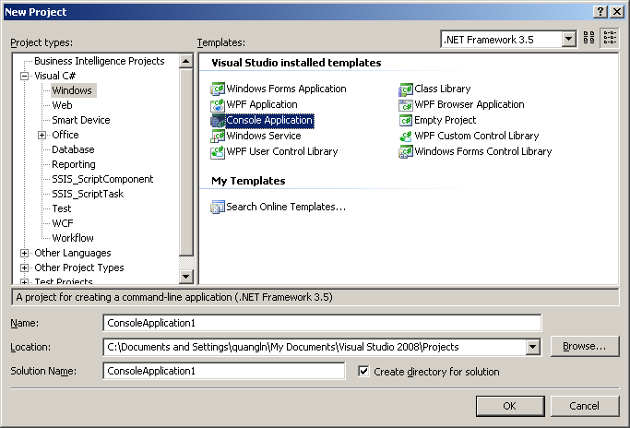
Building .NET Applications using Visual Studio 2008
Use Console Application template

Slide 10
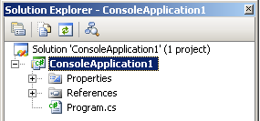
Building .NET Applications using Visual Studio 2008
The Solution Explorer utility

Slide 11
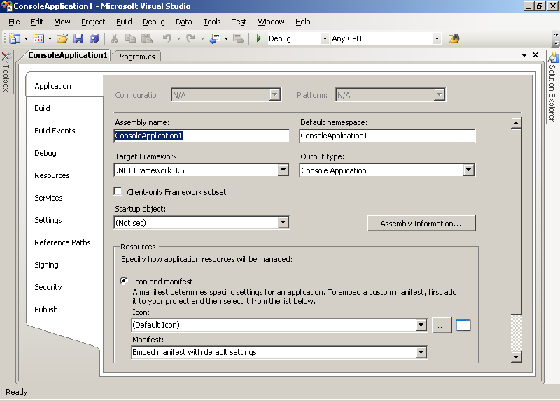
Building .NET Applications using Visual Studio 2008
The Project Properties window

Slide 12
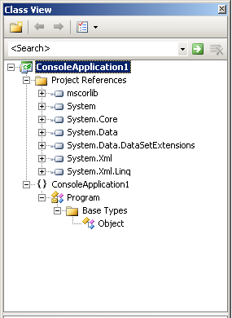
Building .NET Applications using Visual Studio 2008
The Class View utility

Slide 13
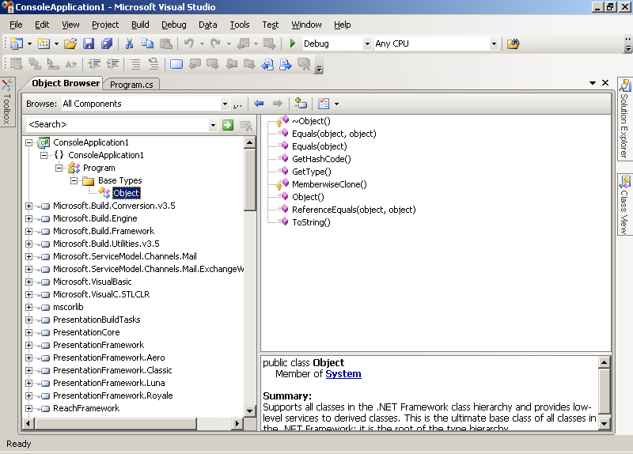
Building .NET Applications using Visual Studio 2008
The Object Browser utility

Slide 14
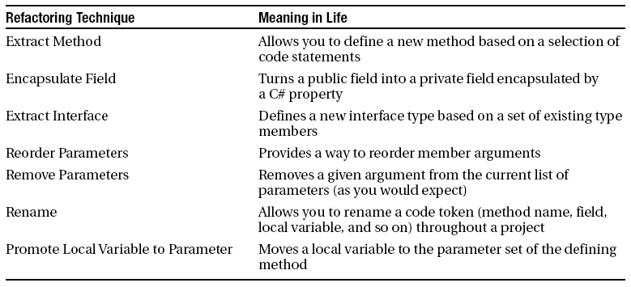
Building .NET Applications using Visual Studio 2008
Integrated support for code refactoring
  Refactoring is a formal and mechanical process whereby you improve an existing code base

Slide 15
Building .NET Applications using Visual Studio 2008
Code expansions and Surround with technology
  The capability to insert complex blocks of C# code using menu selections, context-sensitive mouse clicks, and/or keyboard shortcuts. There are two main groups:
    Snippets: These templates insert common code blocks at the location of the mouse cursor.
    Surround With: These templates wrap a block of selected statements within a relevant scope.

Slide 16
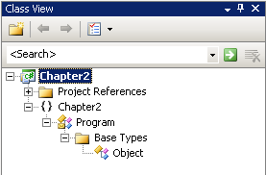
Building .NET Applications using Visual Studio 2008
The Visual Class Designer
Inserting a class diagram file

Slide 17
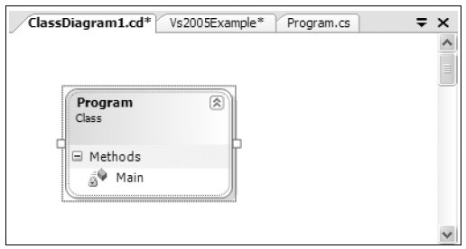
Building .NET Applications using Visual Studio 2008
The Visual Class Designer
The Class Diagram viewer

Slide 18
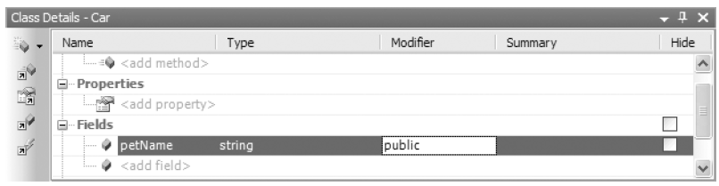
Building .NET Applications using Visual Studio 2008
The Visual Class Designer
Adding a field with the Class Details window

Slide 19
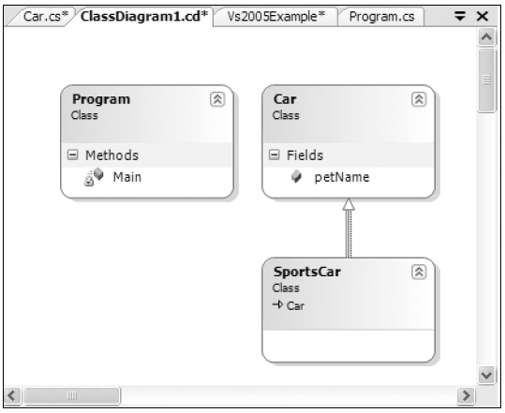
Building .NET Applications using Visual Studio 2008
The Visual Class Designer
Visually deriving from an existing class

Slide 20
Home reading
Building .NET applications using TextPad (page 94)
Building .NET applications using SharpDevelop (page 99)

Slide 21
Q & A

